Slide 1
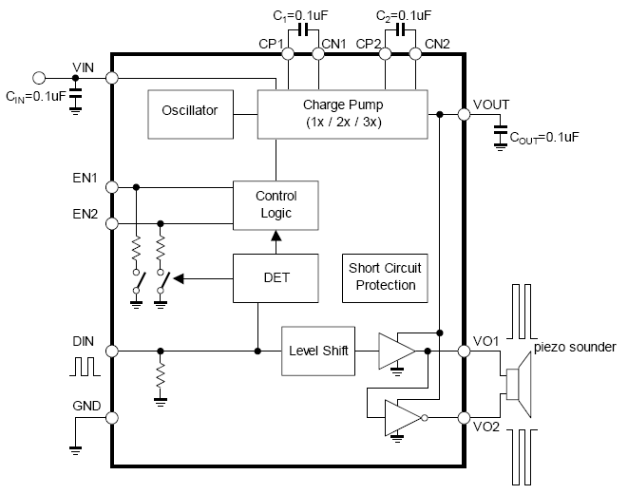
Off the shelf charge pump + horn Driver
PAM8904/NJU72501/MAS6240
Input:2.3~5.5V
Output: 18Vpp@3V

Slide 2
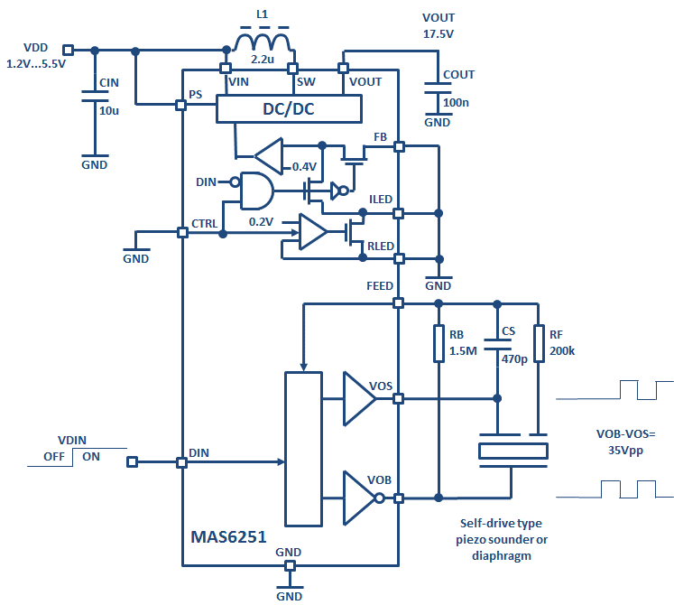
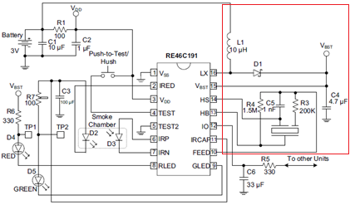
Off the shelf DC-DC boost converter+ horn Driver
MAS6251
Input:1.2~5.5V
Output: up to 35Vpp
RE46C190/1
Input:2~5V
Output: up to 20Vpp

Slide 3
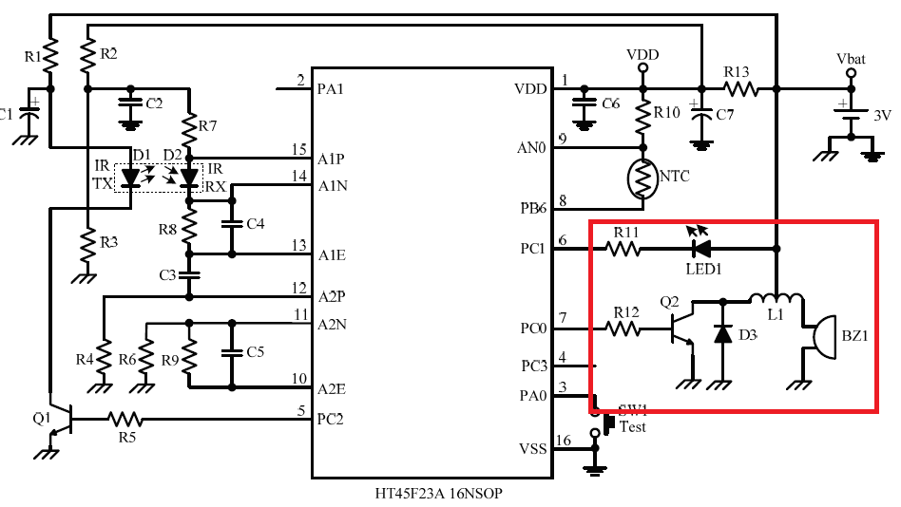
Simple BJT+Inductor horn Driver

Slide 4
Piezo Horn Driver Discussion
9V電源輸入現行採用方案? DC-DC ,Charge pump or others?
3.3V以下電源輸入現行採用方案? DC-DC ,Charge pump or others?
目前的驅動Buzzer最高的VPP是多少? 期望的Vpp是多大?
What’s the target price for GMT proposal?

Slide 5
GMT Proposal
DC-DC Boost Converter
Input 1.8V~9V
Output: up to 17.5V
Max. output current 100mA
High efficiency
VCC=1.8~9V
DC-DC
mode_sel
Horn Driver
Differential Drive up to 35 Vpp
2. PWM or ON/OFF mode
PWM for external Drive(mode_sel=1)
On/Off for self drive(mode_sel=0)
PWM
Driver
or
ON/OFF

